Slide 1
ELEC5620M Embedded Microprocessor System Design
Unit 1.2 Pointers and Functions
Dr David Cowell Module Leader d.m.j.cowell@leeds.ac.uk
Prof Steven Freear

Slide 2


Reference Textbooks - C
Practical C Programming
The C Programming Language
Minerva > ELEC5620M > Module Information > Module Reading List

Slide 3
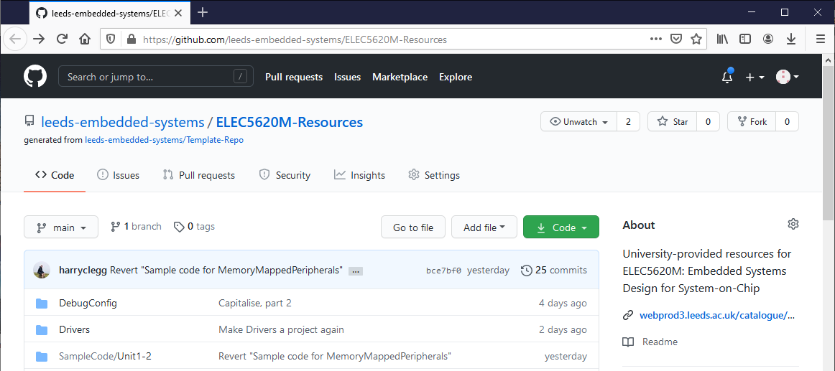
GitHub ELEC5620M-Resources
Minerva > ELEC5620M > General Resources > Lab Resources on GitHub

Slide 4
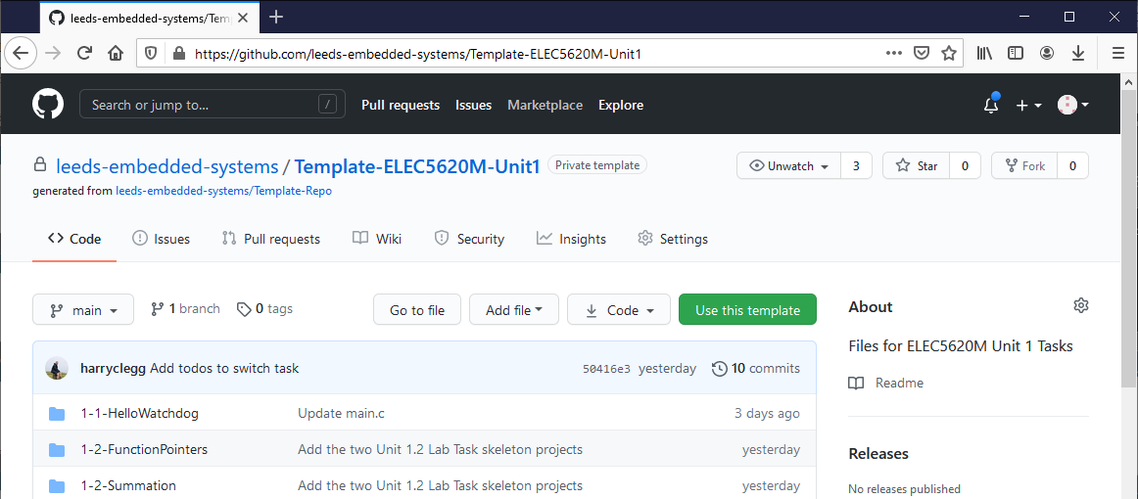
GitHub ELEC5620M-Unit1
Minerva > ELEC5620M > Unit 1 > Unit 1 GitHub Classrooms Resources

Slide 5
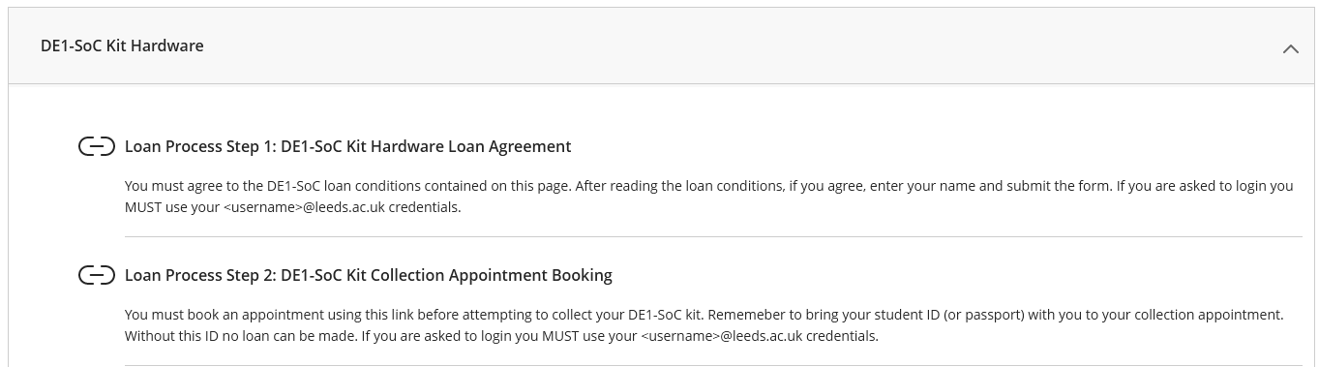
DE1-SoC Hardware Loan
You need the DE1-SoC hardware to complete the tasks and future assessments!

Slide 6

Hardware Loan

Slide 7
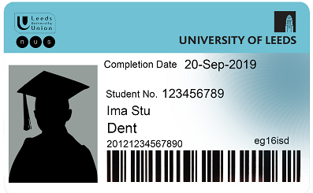


Hardware Loan

Slide 8
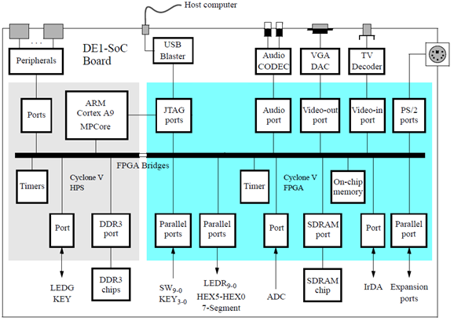

Slide 9
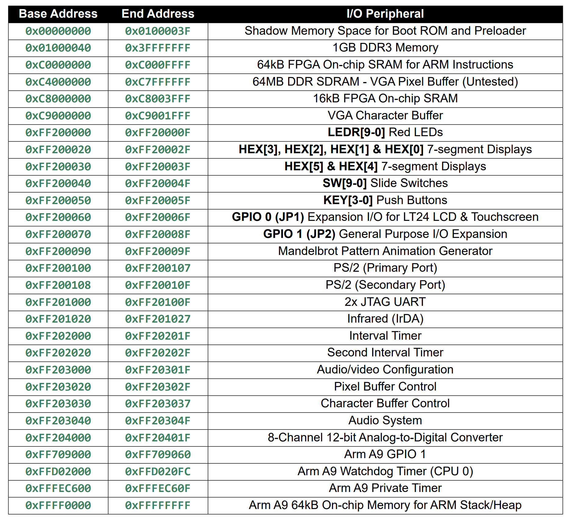

Slide 10
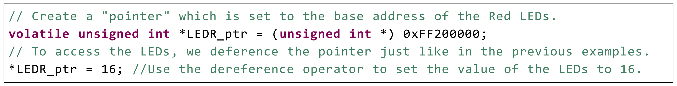
Memory Mapped Peripherals Outputs - LEDs

Slide 11
Memory Mapped Peripherals Outputs - LEDs
Why 16?
Think in binary… think in hexadecimal!
Use Windows Calculator – Programmer mode!
5th LED from right (LED4) illuminated!

Slide 12
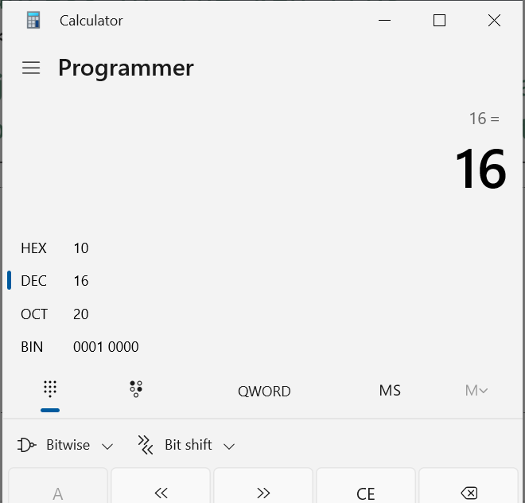
Memory Mapped Peripherals Outputs - LEDs
Why 16?
Think in binary… think in hexadecimal!
Use Windows Calculator – Programmer mode!
5th LED from right (LED4) illuminated!

Slide 13
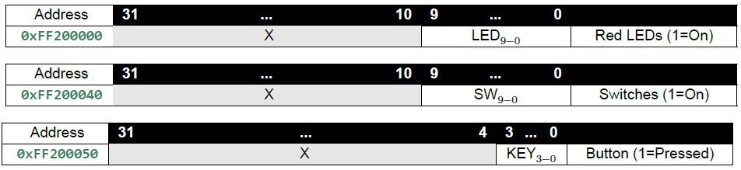
1-1-HelloWatchdog main.c
int main(void) {
// Declare pointers to I/O registers
// (volatile keyword means memory not cached)
// WDT Current Value Register (l4wd0: wdt_ccvr)
volatile unsigned int *wdt_ccvr = (unsigned int *)0xFFD02008;
// WDT Counter Reload Register (l4wd0: wdt_crr)
volatile unsigned int *wdt_crr = (unsigned int *)0xFFD0200C;
// Red LEDs base address
volatile int *LEDR_ptr = (int *)0xFF200000;
// KEY buttons base address
volatile int *KEY_ptr = (int *)0xFF200050;
...

Slide 14
1-1-HelloWatchdog main.c
int main(void) {
// Declare pointers to I/O registers (volatile keyword means memory not cached)
volatile unsigned int *wdt_ccvr = (unsigned int *)0xFFD02008; // WDT Current Value Register (l4wd0: wdt_ccvr)
volatile unsigned int *wdt_crr = (unsigned int *)0xFFD0200C; // WDT Counter Reload Register (l4wd0: wdt_crr)
volatile unsigned int *LEDR_ptr = (unsigned int *)0xFF200000; // Red LEDs base address
volatile unsigned int *KEY_ptr = (unsigned int *)0xFF200050; // KEY buttons base address
// Primary Run Loop - Bare-Metal Applications use an infinite loop to keep executing (no OS).
while (1) {
// Read WDT counter value and display it on the red LEDs (scaled to fit).
*LEDR_ptr = *wdt_ccvr >> 16;
//Check if any of the buttons have been pressed.
//Each of the lower 4 bits represents one of the keys. A key is pressed if the corresponding bit is 1.
if (*KEY_ptr & 0xF) {
// If any key pressed
*wdt_crr = 0x76; // Reset the Watchdog Timer
}
}
}

Slide 15
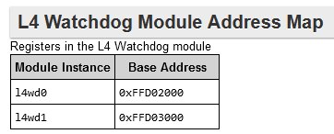
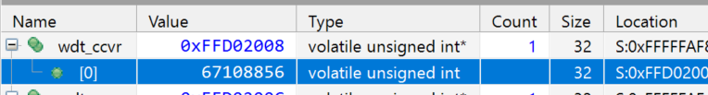
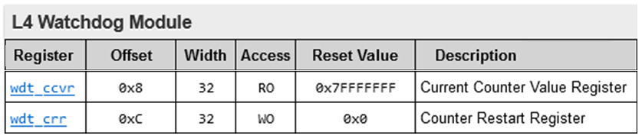
Watchdog Timer Reset
Challenge:
Use debugger and check the wdt_torr register to determine wdt_ccvr reset value.

Slide 16
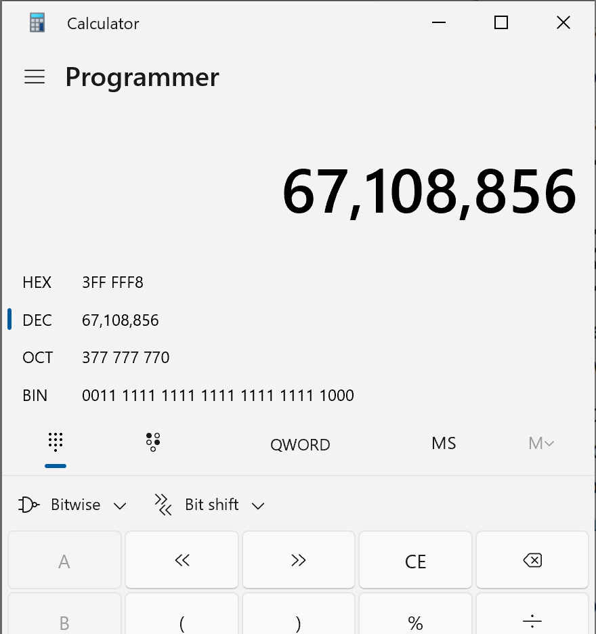
Watchdog Timer Reset
26 bits
Challenge:
Use debugger and check the wdt_torr register to determine wdt_ccvr reset value.

Slide 17
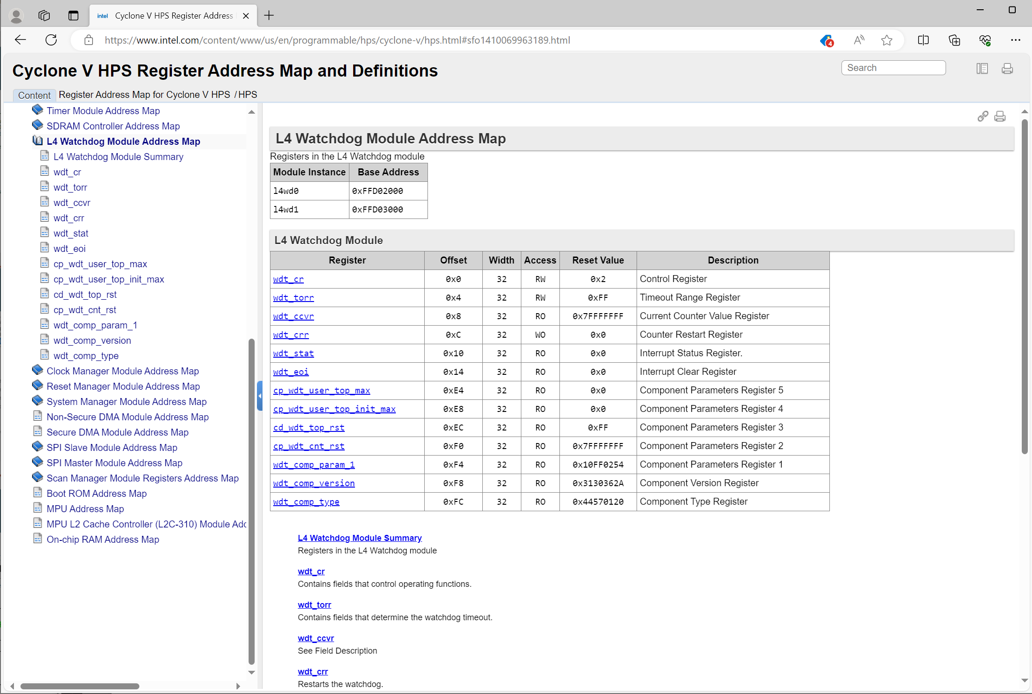

Slide 18
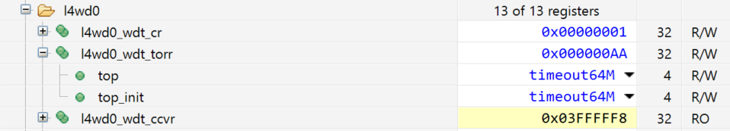
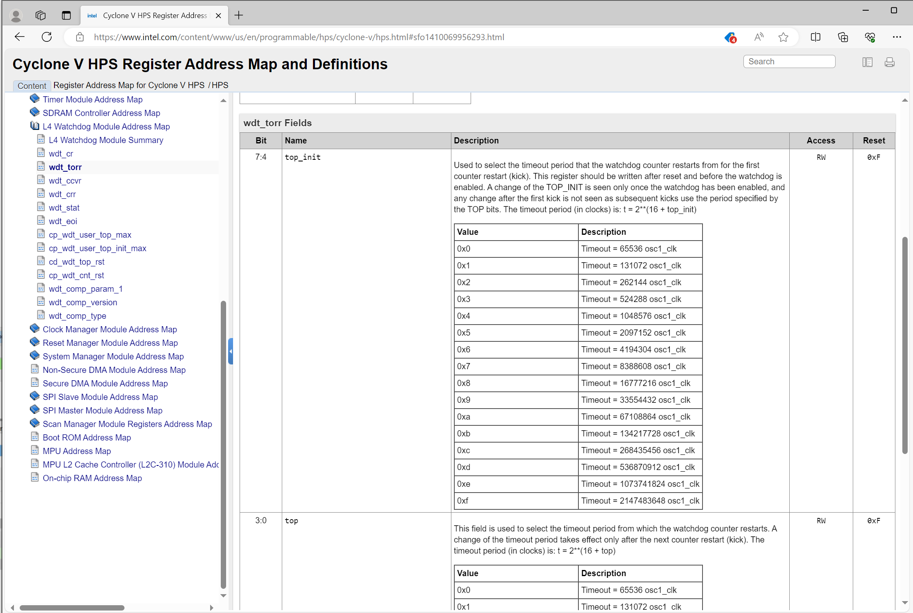

Slide 19
1-1-HelloWatchdog main.c
int main(void) {
// Declare pointers to I/O registers
// (volatile keyword means memory not cached)
// WDT Current Value Register (l4wd0: wdt_ccvr)
volatile unsigned int *wdt_ccvr = (unsigned int *)0xFFD02008;
// WDT Counter Reload Register (l4wd0: wdt_crr)
volatile unsigned int *wdt_crr = (unsigned int *)0xFFD0200C;
// Red LEDs base address
volatile int *LEDR_ptr = (int *)0xFF200000;
// KEY buttons base address
volatile int *KEY_ptr = (int *)0xFF200050;
...

Slide 20
Bit shifting 1-1-HelloWatchdog - main.c
while (1) {
// Read WDT counter value, and display it on the red LEDs (scaled to fit).
*LEDR_ptr = *wdt_ccvr >> 16;
bit 31 30 29 28 27 26 25 24 23 22 21 20 19 18 17 16 15 14 13 12 11 10 9 8 7 6 5 4 3 2 1 0
*wdt_ccvr 0 0 0 0 0 0 1 1 1 1 1 1 1 1 1 1 1 1 1 1 1 1 1 1 1 1 1 1 0 0 0 0
16 lost bits
16 Zero Padding Bits
*wdt_ccvr>>16 0 0 0 0 0 0 0 0 0 0 0 0 0 0 0 0 0 0 0 0 0 0 1 1 1 1 1 1 1 1 1 1
Example of bit shifting – Lookup >> and << in reference texts.

Slide 21
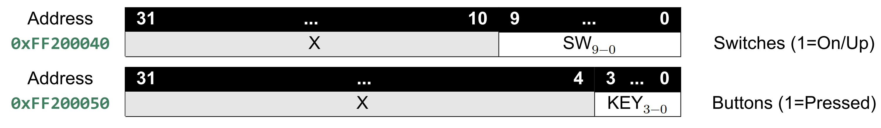
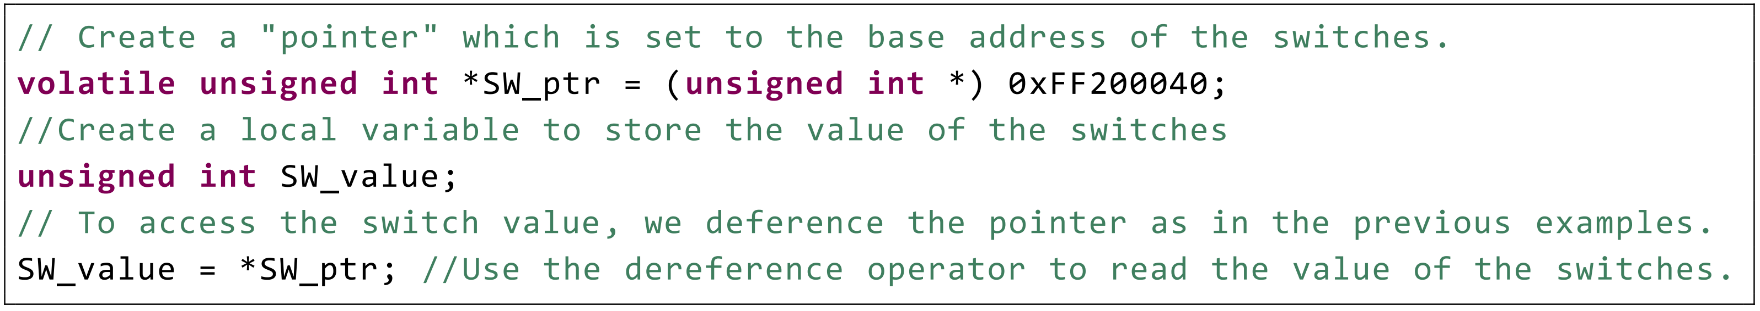
Memory Mapped Peripherals Inputs – Switches and Buttons

Slide 22
1-1-HelloWatchdog main.c
int main(void) {
// Declare pointers to I/O registers
// (volatile keyword means memory not cached)
// WDT Current Value Register (l4wd0: wdt_ccvr)
volatile unsigned int *wdt_ccvr = (unsigned int *)0xFFD02008;
// WDT Counter Reload Register (l4wd0: wdt_crr)
volatile unsigned int *wdt_crr = (unsigned int *)0xFFD0200C;
// Red LEDs base address
volatile int *LEDR_ptr = (int *)0xFF200000;
// KEY buttons base address
volatile int *KEY_ptr = (int *)0xFF200050;
...

Slide 23
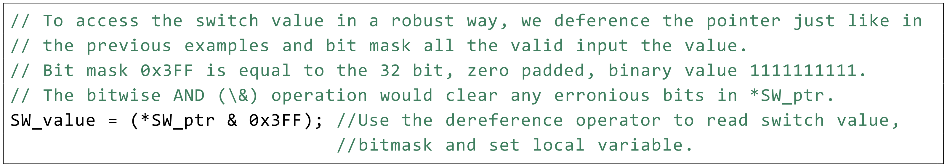
Memory Mapped Peripherals Inputs – Switches and Buttons

Slide 24
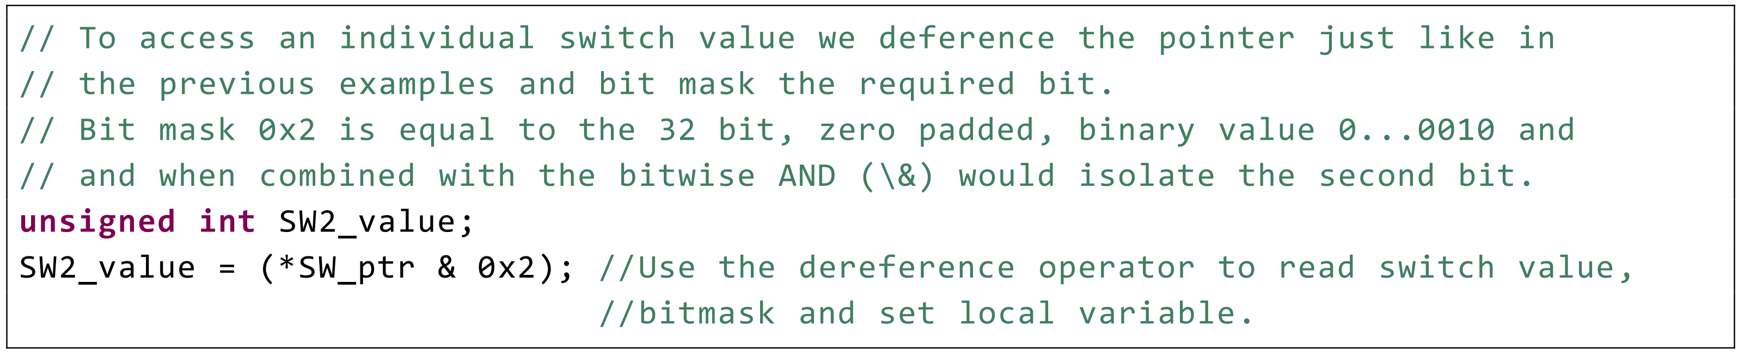
Memory Mapped Peripherals Inputs – Switches and Buttons

Slide 25
Bit masking 1-1-HelloWatchdog - main.c
/**
* Check if any of the buttons have been pressed.
* Each of the lower 4 bits represents one of the keys.
* A key is pressed if the corresponding bit is 1.
*/
if (*KEY_ptr & 0xF) {
// If any key pressed
*wdt_crr = 0x76; // Reset the Watchdog Timer
}
}
}
A | B | A & B
0 | 0 | 0
0 | 1 | 0
1 | 0 | 0
1 | 1 | 1
bit 31 30 29 28 27 26 25 24 23 22 21 20 19 18 17 16 15 14 15 13 12 11 10 9 8 7 6 5 4 3 2 1 0
*KEY_ptr X X X X X X X X X X X X X X X X X X X X X X X X X X X X X 0 0 0 1
0xF (0x000F) 0 0 0 0 0 0 0 0 0 0 0 0 0 0 0 0 0 0 0 0 0 0 0 0 0 0 0 0 0 1 1 1 1
(*KEY_ptr & 0xF) 0 0 0 0 0 0 0 0 0 0 0 0 0 0 0 0 0 0 0 0 0 0 0 0 0 0 0 0 0 0 0 0 1

Slide 26
Bit masking 1-1-HelloWatchdog - main.c
/**
* Check if any of the buttons have been pressed.
* Each of the lower 4 bits represents one of the keys.
* A key is pressed if the corresponding bit is 1.
*/
if (*KEY_ptr & 0xF) {
// If any key pressed
*wdt_crr = 0x76; // Reset the Watchdog Timer
}
}
}
A | B | A & B
0 | 0 | 0
0 | 1 | 0
1 | 0 | 0
1 | 1 | 1
Erroneous high bit defeated with bit masking!!!
bit 31 30 29 28 27 26 25 24 23 22 21 20 19 18 17 16 15 14 15 13 12 11 10 9 8 7 6 5 4 3 2 1 0
*KEY_ptr 0 0 0 0 0 0 0 0 0 0 0 0 1 0 0 0 0 0 0 0 0 0 0 0 0 0 0 0 0 0 0 0 1
0xF (0x000F) 0 0 0 0 0 0 0 0 0 0 0 0 0 0 0 0 0 0 0 0 0 0 0 0 0 0 0 0 0 1 1 1 1
(*KEY_ptr & 0xF) 0 0 0 0 0 0 0 0 0 0 0 0 0 0 0 0 0 0 0 0 0 0 0 0 0 0 0 0 0 0 0 0 1

Slide 27
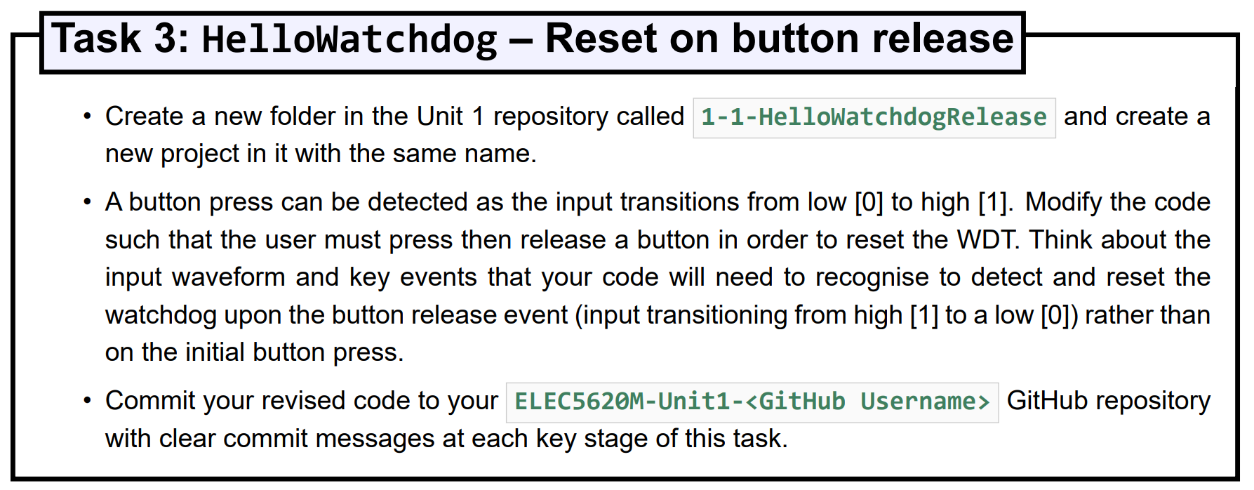
Unit 1.1 Task 3: HelloWatchdog – Reset on button release

Slide 28
Unit 1.1 Task 3: HelloWatchdog – Reset on button release
START
Button
1 2 3 4 1
while (1)
{
// Read WDT counter value, and display it on the red LEDs
*LEDR_ptr = *wdt_ccvr >> 16;
//Check if any of the buttons have been pressed.
if (*KEY_ptr & 0xF) // Key pressed?
{
while (*KEY_ptr & 0xF)
{
// Key still pressed - update LEDs with wdt_ccvr
*LEDR_ptr = *wdt_ccvr >> 16;
}
// Key released - Reset WDT
*wdt_crr = 0x76;
}
}
Update LEDs with WDT CCVR
1
KEY pressed?
FALSE
TRUE 2
KEY still pressed?
Reset WDT
FALSE
4
TRUE 3
Update LEDs with WDT CCVR

Slide 29
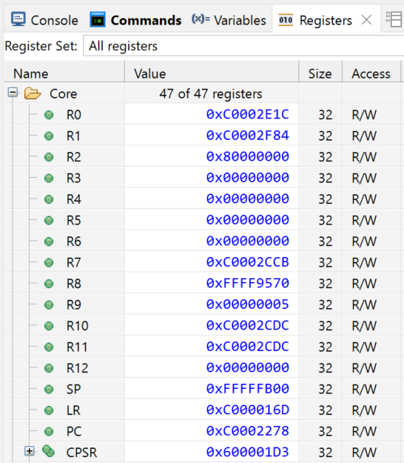
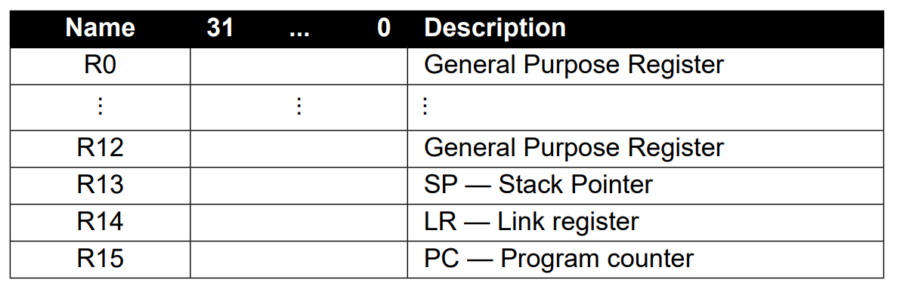
Arm General Purpose Registers

Slide 30
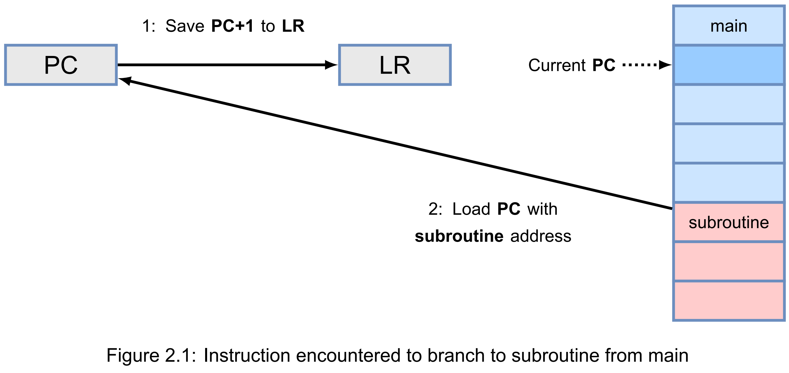
Branching – function calls – subroutines!

Slide 31
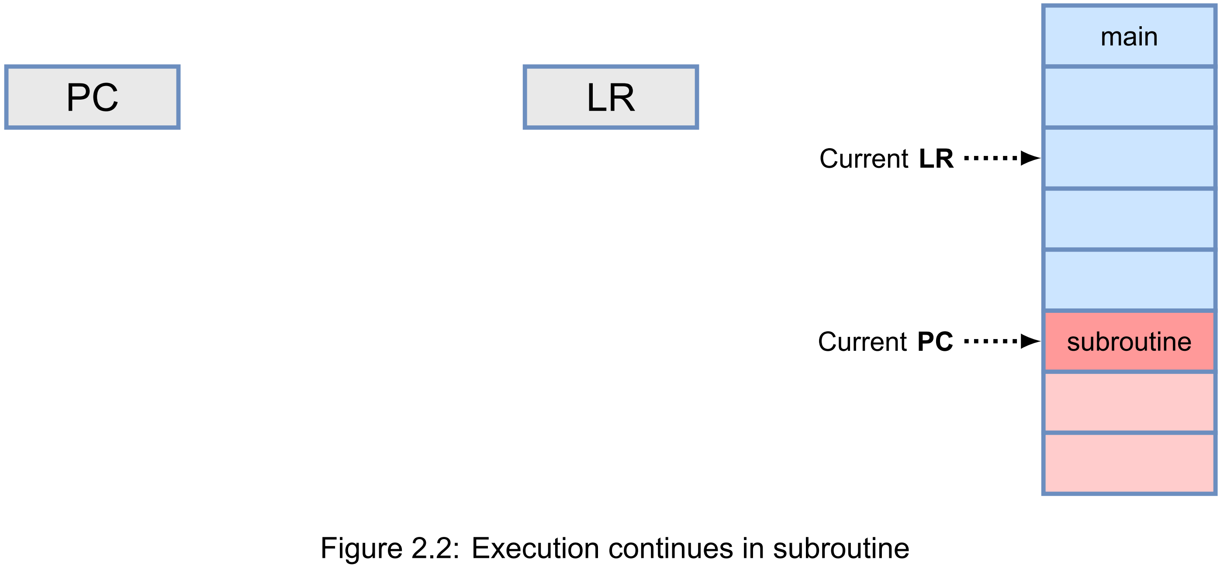
Branching – function calls – subroutines!

Slide 32
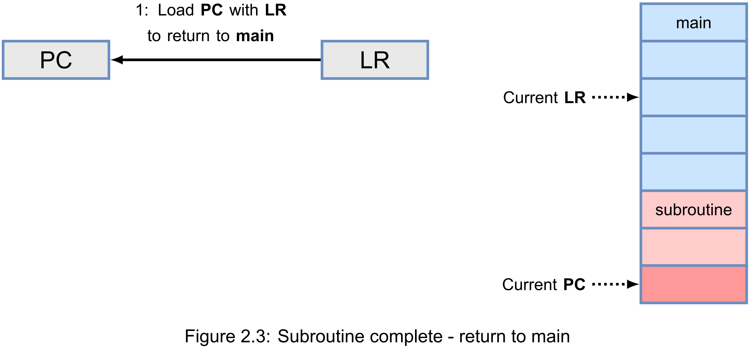
Branching – function calls – subroutines!

Slide 33
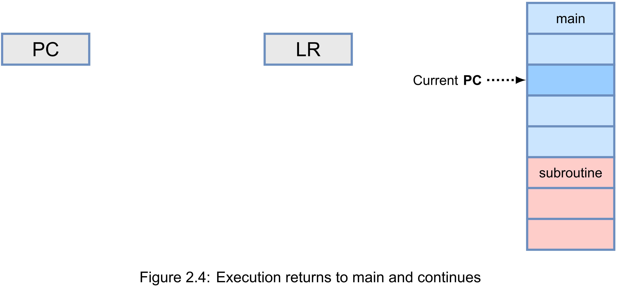
Branching – function calls – subroutines!

Slide 34
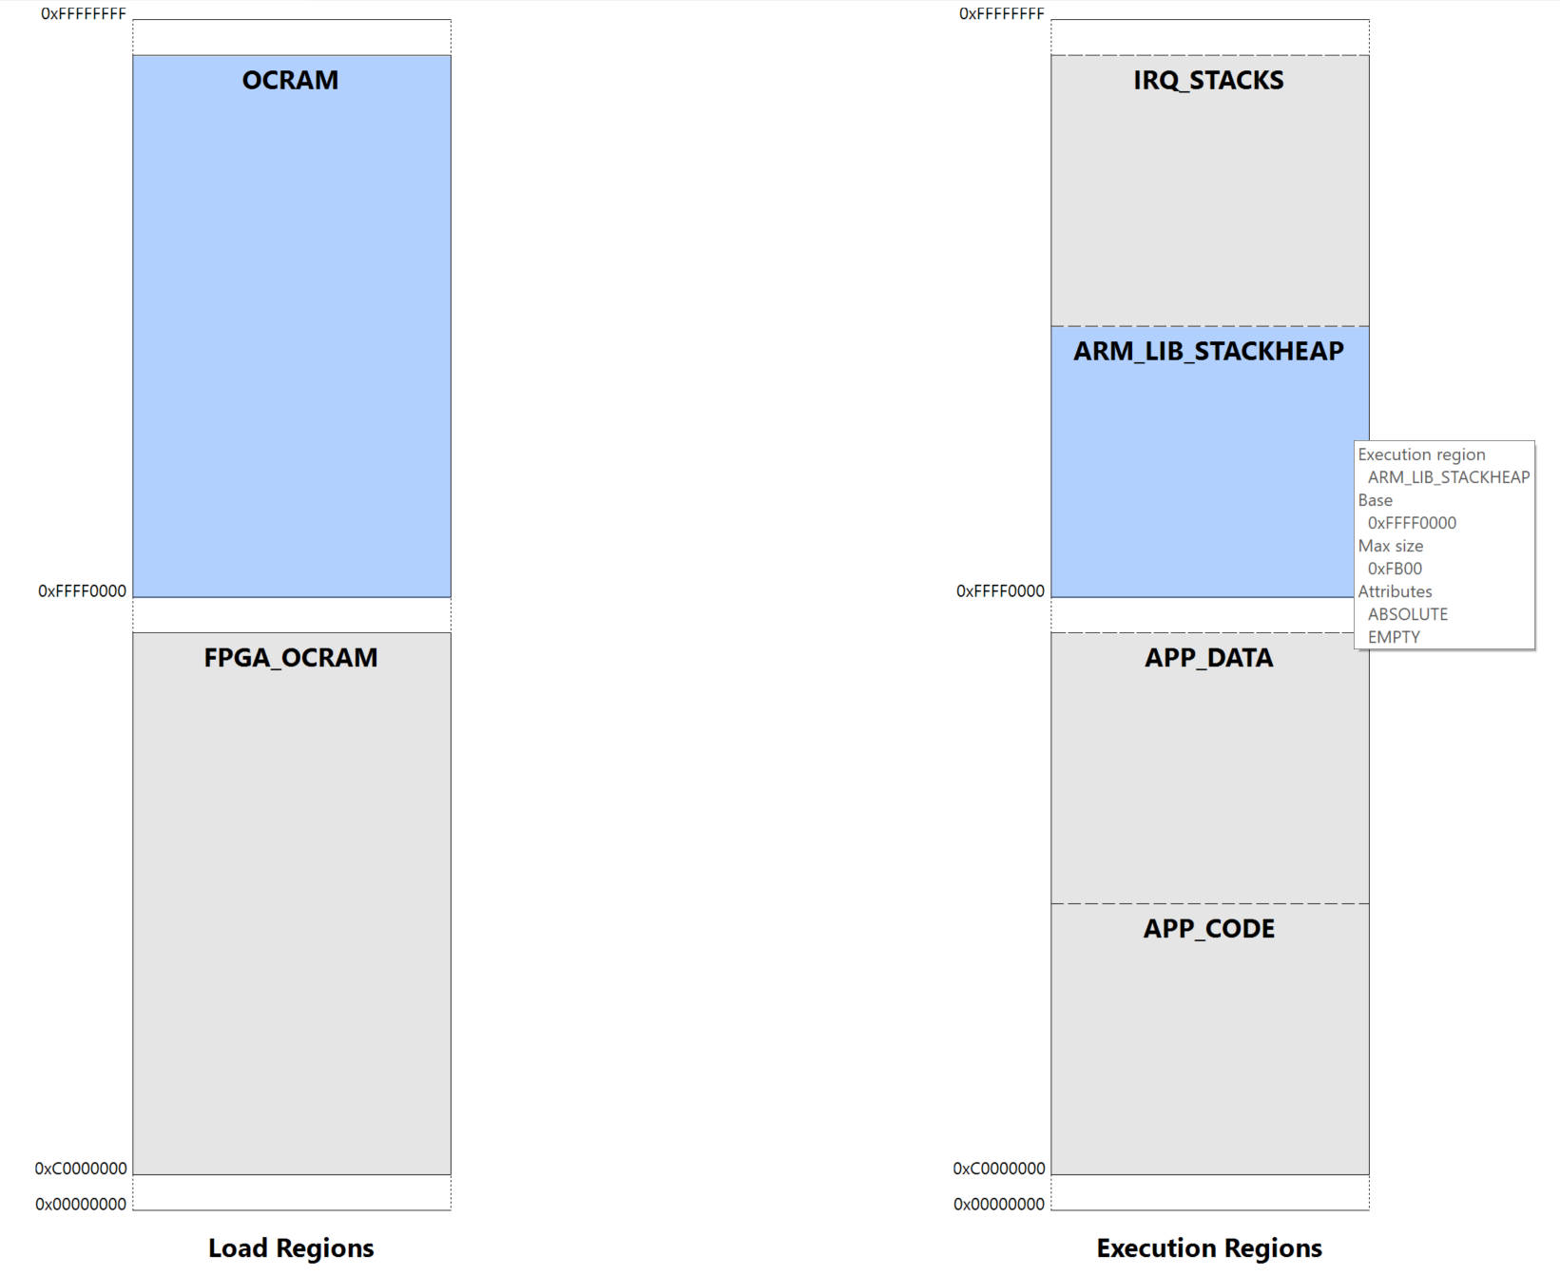
Stack
0xFFFF FFFF
Base Addr. End Addr. I/O Peripheral
0xFFFF0000 0xFFFFFFFF Arm A9 64kB On-chip Memory for ARM Stack/Heap
0xFFFEC600 0xFFFEC60F Arm A9 Private Timer
0xFFD02000 0xFFD020FC Arm A9 Watchdog Timer (CPU 0)
0xFF709000 0xFF709060 Arm A9 GPIO 1
0xFF204000 0xFF20401F 8-Channel 12-bit ADC
0xFF203040 0xFF20304F Audio System
0xFF203030 0xFF203037 Character Buffer Control
0xFF203020 0xFF20302F Pixel Buffer Control
0xFF203000 0xFF20301F Audio/video Configuration
0xFF202020 0xFF20202F Second Interval Timer
0xFF202000 0xFF20201F Interval Timer
0xFF201020 0xFF201027 Infrared (IrDA)
0xFF201000 0xFF20100F 2x JTAG UART
0xFF200108 0xFF20010F PS/2 (Secondary Port)
0xFF200100 0xFF200107 PS/2 (Primary Port)
0xFF200090 0xFF20009F Mandelbrot Generator
0xFF200070 0xFF20008F GPIO 1 (JP2) I/O Expansion
0xFF200060 0xFF20006F GPIO 0 (JP1) LT24 LCD & Touchscreen
0xFF200050 0xFF20005F KEY[3-0] Push Buttons
0xFF200040 0xFF20004F SW[9-0] Slide Switches
0xFF200030 0xFF20003F HEX[5-4] 7-segment Displays
0xFF200020 0xFF20002F HEX[3-0] 7-segment Displays
0xFF200000 0xFF20000F LEDR[9-0] Red LEDs
0xC9000000 0xC9001FFF VGA Character Buffer
0xC8000000 0xC8003FFF 16kB FPGA On-chip SRAM
0xC4000000 0xC7FFFFFF 64MB DDR SDRAM - VGA Pixel Buffer
0xC0000000 0xC000FFFF 64kB FPGA On-chip SRAM for ARM Instructions
0x01000040 0x3FFFFFFF 1GB DDR3 Memory
0x00000000 0x0100003F Shadow Boot ROM and Preloader
0xFFFF FB00
0xFFFF 0000
0xC000 FFFF
0xC000 0000
0x0000 0000

Slide 35
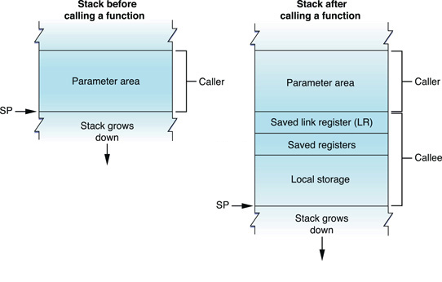
Stack Operation
0xFFFF FB00
0xFFFF 0000
0xFFFF EFFF MPU L2 cache controller - Stray here and you’ll crash the processor!

Slide 36
Function Pointers
int aFunction(int a, int b) {
int c = a + b;
return c;
}
int anotherFunc(int a, int b) {
int c = a * b;
return c;
}
As the function is simply code in memory,
you can in fact create a pointer to the function.
typedef int (*TaskFunction)(int, int);
int main(void) {
// Create a pointer to aFunction.
TaskFunction aPointer = &aFunction;
// Create some inputs
int a = 4;
int b = 6;
// Try calling the function
int c = aPointer(a, b);
// Do nothing, forever.
while (1) {
HPS_ResetWatchdog();
}
}

Slide 37
Questions

